Slide 2
World War II
The war that changed the world

Slide 3
The Road to World War II
Treaty of Versailles ended World War I
It was not based on Wilson’s Fourteen Points and enraged some countries
Germany (War Guilt Clause and Reparations)
Italy (Didn’t get the land they wanted)
Japan (Didn’t get all of the land they wanted)
Soviet Union (Left out of the talks)
Notes:
Germany was blamed totally for the WWI
Other countries felt they had been excluded from any gains after they had fought in the war
Wilson’s plan, 14 points, rejected by the other Allies because of Clause 321, the War Guilt Clause

Slide 4
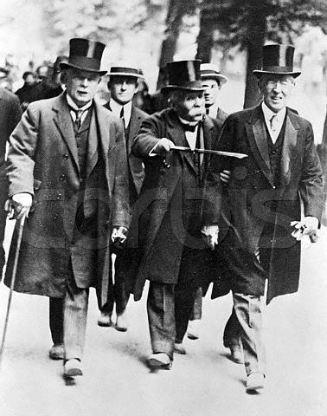
Why? (underlying causes of WWII)
Treaty of Versailles
Germany lost land to surrounding nations
War Reparations
Allies collect $ to pay back war debts to U.S.
Germany must pay $57 trillion (modern equivalent)
Bankrupted the German economy & embarrassed Germans
https://www.youtube.com/watch?v=KfnEy8FuElc&t=348s
Lloyd George, Georges Clemenceau, and Woodrow Wilson during negotiations for the Treaty

Slide 5
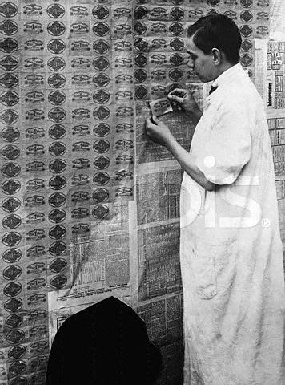
Why? (underlying causes of WWII)
World-wide Depression
The Depression made Germany’s debt even worse
Desperate people turn to any leader who promises a return to better times
Hitler seemed to provide solutions to Germany’s problems
https://www.youtube.com/watch?v=yEk6zGYwyhc
1923 - Wallpapering with German Deutchmarks

Slide 6
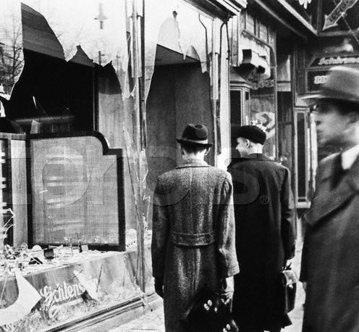
Why? (underlying causes of WWII)
World-wide Depression
Hitler provided scapegoats for Germany’s problems (foreigners, Jews, communists, Roma (Gypsies), mentally ill, homosexuals)
Kristallnacht - vandalism & destruction of Jewish property & synagogues
Notes:
Hitler wanted the Jews to leave Germany so allowed and encourage their harrasment by others

Slide 7
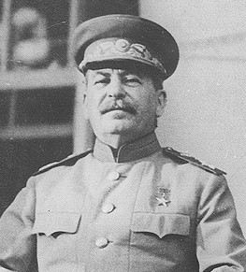
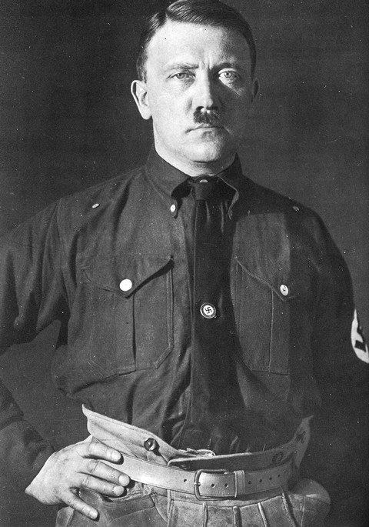
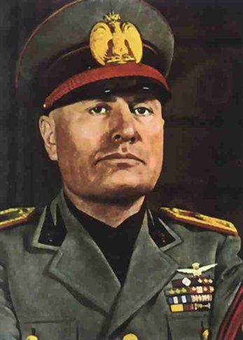
Dictators Gain Power
Benito Mussolini Joseph Stalin Adolf Hitler
The world wide Depression of the 1930s made it easier for dictators to gain control in many European Countries. There was an increase in militarism during this time period.
Notes:
Desperate times made it easier for these men to gain control.
They were charismatic, great speaker

Slide 8
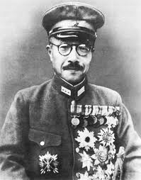
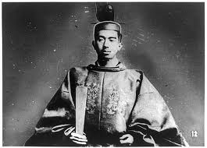
JAPANESE MILITARISM
After WW1, Japan's economic situation worsened. The Great Kanto Earthquake of 1923 and the world wide depression of 1929 intensified the crisis.
During the 1930s, the military established almost complete control over the government.
Navy and army officers soon occupied most of the important offices, including the one of the prime minister.
General Tojo
Emperor Hirohito
Notes:
Militarism will bring back Japan’s glory days
Nationalism - expand Japan’s borders

Slide 9
Acts of Aggression

Slide 10
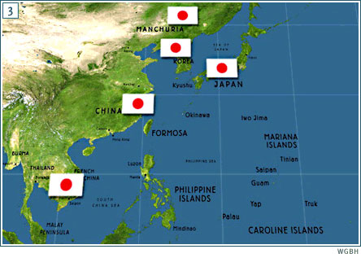
Acts of Aggression
Japan Invades Manchuria and Chinese cities
League of Nations threatens but takes NO action
Japan withdraws from the League of Nations
http://www-tc.pbs.org/wgbh/amex/pacific/maps/images/maps_01_03.jpg
Notes:
League of Nations has no real power to stop them
Japanese ambassador walks out of the League of Nations as Japan is condemned for their actions

Slide 11
Italy Invades Africa
Italy invades Ethiopia
Ethiopian King appeals to League of Nations
League of Nations will not sell war supplies or goods to Italy
Notes:
Ethiopia no match for Italy - had only basic spears, etc. to fight bullets, tanks and guns
Italy had no chance of losing
Increased national pride – no economic value in Ethiopia
L of N placed an embargo on Italy

Slide 12
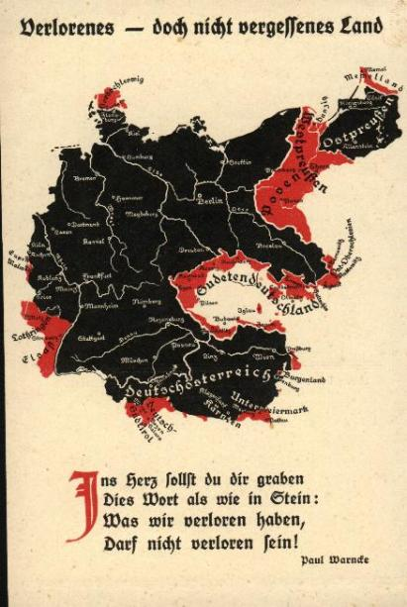
“Lost but not forgotten land”
You must carve in your heart
These words, as in stone -
What we have lost
Will be regained!
Notes:
German postcard, produced about the time of the Treaty of Versailles, showing the land where Germans lived. The areas in red are the lands given to other countries by the Treaty of Versailles,( including the land lost by Austria).
Its title is 'Lost but not forgotten land'.

Slide 13
German Aggression Begins
Nazi Party Comes to power
Anti - Semitic feelings spread
Rearmament
Hitler/Stalin sign Non-Aggression Pact
Hitler comes to power and follows “Mein Kampf” - his goals for Germany
Notes:
The Jews were an easy target because they were different
Re-armament in violation of the Treaty of Versailles
Put people back to work as they built up the military
Hitler had the Autobahn built throughout Germany – really built for the military so they could easily move troops and supplies – Hitler had a plan
Pact stated that Germany and Russia would not fight each other
“Mein Kampf” distributed to Germans

Slide 14
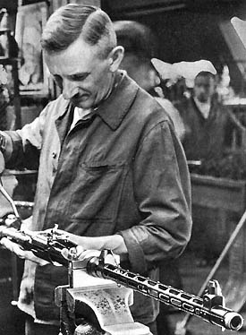
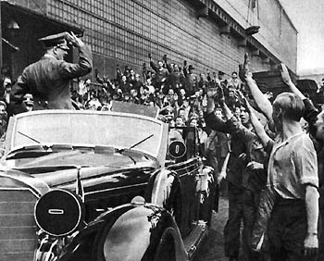
Hitler soon ordered a programme of rearming Germany
Hitler visits a factory and is enthusiastically greeted. Many Germans were grateful for jobs after the misery of he depression years.
Notes:
Rearmament in violation of the Versailles Treaty
League’s failure to stop this convinced Hitler to take even great risks
Unemployment dropped dramatically from 6 million to 1 million

Slide 15
German Aggression
https://www.youtube.com/watch?v=VTdV9JaHiIA
Germany invades Rhineland
Germany annexes Austria
Germany invades Sudetenland
Notes:
Hitler had long pledged to undo the Versailles Treaty

Slide 16
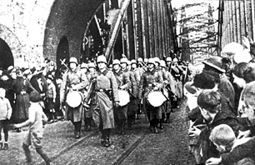
March 1936: German troops marched into the Rhineland
The Rhineland was a region of Germany that was ‘demilitarised’ after the Treaty of Versailles. Germany was not allowed to have troops in the region.
Hitler’s actions showed how he was willing to directly challenge the treaty.
Notes:
Rhineland (western part of Germany) was supposed to be a demilitarized zone – a buffer zone between Germany and France according to the Treaty.
It was an important industrial area. It contained significant mineral deposits, (coal, lead, lignite, magnesium, oil and uranium) and water transport
German reoccupation of the Rhineland marked a turning point in the march toward war
It strengthened Hitler’s power and prestige within Germany.
It also changed the balance of power in Germany’s favor. Left France and Belgium open to any future German attack
Finally, the weak response by France and Britain encouraged Hitler to speed up his expansion.

Slide 17
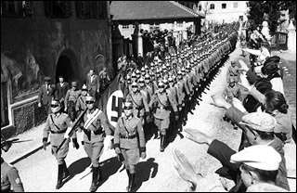
March 1938: Nazi Germany annexed Austria
Again, this went against the terms of the Treaty of Versailles which banned Germany from uniting with Austria.
However, the arrival of German troops was met with great enthusiasm by many Austrian people.
Notes:
Treaty of Versailles prohibited Anschluss or a union between Austria and Germany. Many Austrians supported unity with Germany.
France and Britain ignored their pledge to protect Austrian independence.

Slide 18
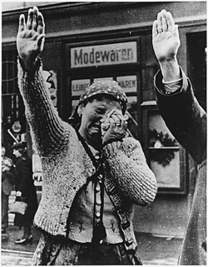
March 1939: Germany invaded Czechoslovakia
Hitler had ordered the occupation of a part of Czechoslovakia known as the Sudetenland (in October 1938). Many hoped that that this would be the last conquest of the Nazis.
However, in March 1939, he ordered his troops to take over the remainder of Czechoslovakia. This was the first aggressive step that suggested that a war in Europe would soon begin.
Notes:
3 million German-speaking people live in the western border regions called the Sudetenland, a heavily fortified area. It formed the Czechs’ mian defense against Germany.
The Anschluss raised hopes among the pro-Nazis living there.
Sept. 1938 Hitler demanded that the Sudetenland be given to Germany.
Czechs refused and asked France for help.

Slide 19
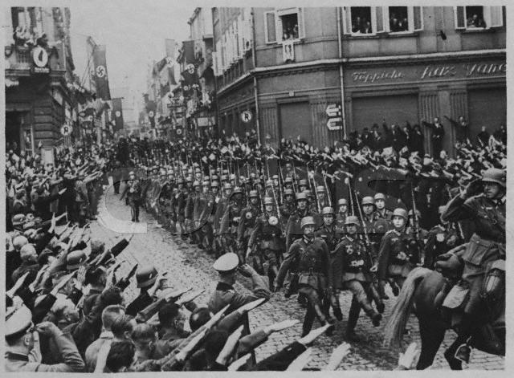
So What Was Hitler Asking For?
Return of German Speaking Lands- “Lebensraum”
Austria - Peacefully Annexed in 1938
German Troops Parade in Streets of Czechoslovakian Town, ca. 1939

Slide 20
Policy of Appeasement
Sept. 29, 1938 at the Munich Conference, Great Britain and France adopt the policy of Appeasement
Appeasement: Giving into the competitor in order to keep peace
Germany is allowed to keep the land taken over - BUT can’t take anymore
https://www.youtube.com/watch?v=hQ95ffnU4Sw
Notes:
Britain and France agree to allow Hitler to have the Sudetenland if he promised to respect Czechoslovakia’s new borders. Winston Churchill disagreed.

Slide 21
Appeasement, What?
After the Munich Conference - Germany continues to invade
Germany took over the rest of Czechoslovakia
Germany invades Poland (September 1, 1939)
Notes:
Within 6 mos., Hitler took over the rest of Germany
Mussolini took Albania
Hitler demands Poland and the Poles refused and turned to Britain and France for aid.
Hitler thought neither nation would risk war.
War now appears to be inevitable.

Slide 22
