Slide 2
The War Begins

Slide 3
German Aggression
Aug. 1939 Hitler signs the Non-Aggression Pact with USSR
Attempts to hold off a two-front war
September 1,1939 invades Poland using “blitzkrieg”
Sept. 3, 1939 Great Britain and France declare war on Germany
Sept. 17 , 1939 USSR invaded Poland (part of non-aggression pact) then moves into Lithuania, Latvia, Estonia and Finland

Slide 5
The War Begins
http://www.ushmm.org/museum/exhibit/online/olympics/images/e40-1z.jpg
After Hitler invades Poland both France and Great Britain declare war on Germany on Sept. 3, 1939
Notes:
Non-Aggression Pact of 1939 where Germany and Soviet Union agreed to not attack one another
Also secretly agreed to divide Poland between them and Soviet Union would also take Finland and the Baltic countries of Lithuania, Latvia and Estonia
Germany launched a surprise attack on Sept. 1, 1939
Tanks and troop trucks crossed the Polish border while Germany aircraft and artillery began a merciless bombing of the capital, Warsaw
This is the final straw – France and Great Britain is declared war on Germany

Slide 6
The War Begins
Before Great Britain and France could respond, Poland fell
Hitler annexed the western half of Poland which had a large German population
This was the first test of Blitzkrieg
Lightening war – use of fast-moving airplanes and tanks followed by massive infantry forces to take enemy by surprise and quickly overwhelm them

Slide 7
The War Continues
Sept. 17, 1939 Stalin sends Soviet troops to occupy the eastern part of Poland
Lithuania, Latvia and Estonia fell
Finland fought fiercely but eventually had to surrender
The Phony War or “Sitzkrieg”
French and British mobilized along the Maginot Line and waited for a German attack
April 9, 1940 – the calm ended and Hitler invades Denmark and Norway

Slide 8
Rescue at Dunkirk
Germans had trapped the Allied forces at Dunkirk- outnumbered, outgunned, and pounded from the air
Trapped with their backs to the sea.
Rescue was one of the most heroic acts of the war
A fleet of about 850 ships were sent across the English Channel to Dunkirk.
Royal Navy ships, civilian craft—yachts, lifeboats, motorboats, paddle steamers, and fishing boats—joined the rescue effort.
May 26 to June 4, under heavy fire from German bombers, boats sailed back and forth from Britain to Dunkirk.
Boats carried some 338,000 battle-weary soldiers to safety.
https://www.youtube.com/watch?v=2b0hNjdbwc4

Slide 9
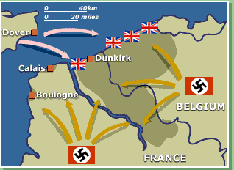
The Fall of France
The Germans invaded France in 1940
Hitler had swept through the Netherlands, Belgium, and Luxembourg
Months later all of France had fallen to the Nazis
Charles de Gaulle escaped to Great Britain to strategize how to get France back
http://www.eyewitnesstohistory.com/images/francesurrenders4.jpg

Slide 10
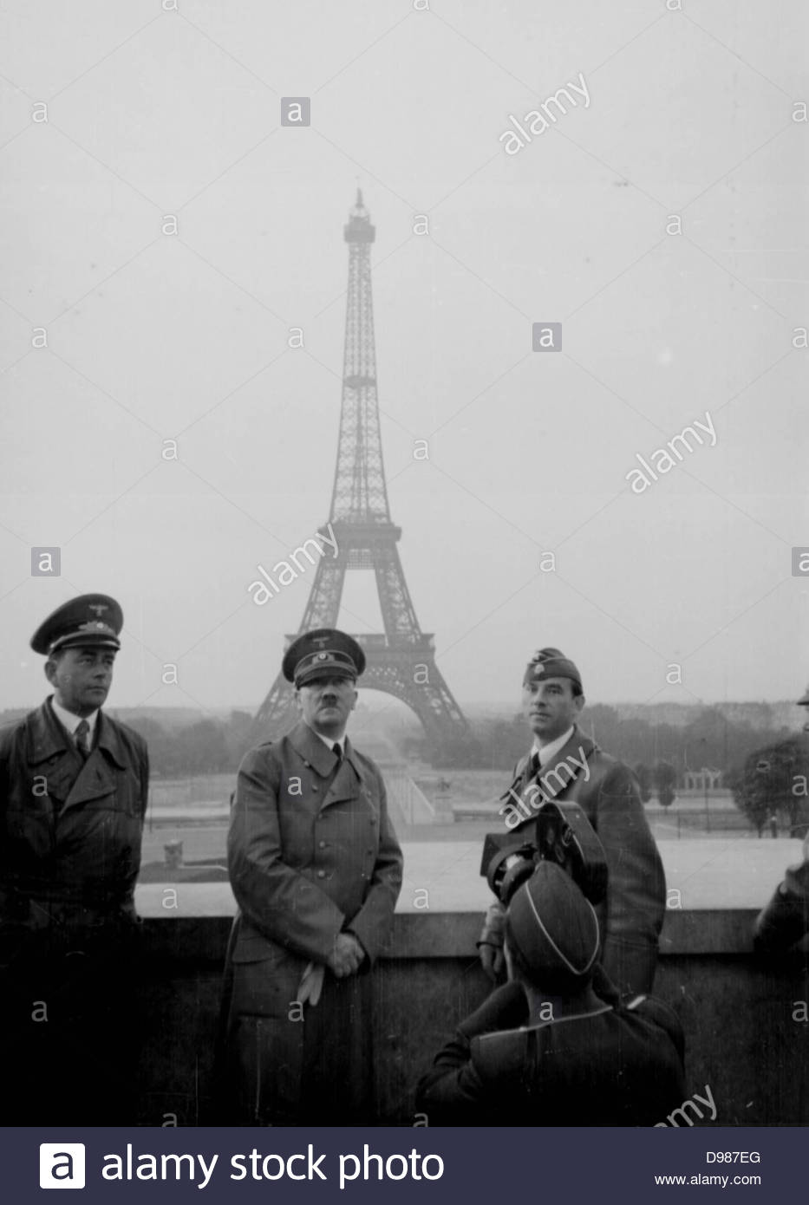

Slide 11
Hitler Invades the Soviet Union
Operation Barbarossa
June 22, 1941 – German tanks and aircraft invade
Soviet Union unprepared
troops ill-equipped and untrained
Within weeks, Germany had pushed 500 miles into the Soviet Union
Soviet Union practiced the scorched earth policy as they retreated
City of Leningrad under siege
One million people starved to death in winter of 1941-1942
Leningrad refused to surrender

Slide 13
Battle of Britain
Germans set out a Blitzkrieg operation in Great Britain
The bombing of Britain lasted for months
British never surrendered
https://www.youtube.com/watch?v=MFeoDO1X-Kg
https://www.youtube.com/watch?v=6vWiJBlwcT4
http://www.worldwar2today.com/images/theblitz.jpg

Slide 14
United States Neutrality
Neutrality Acts declared the US would stay out of war
Americans were fearful of getting involved in another European conflict
Started Cash and Carry policy
http://plasma.nationalgeographic.com/pearlharbor/ngbeyond/images/people_fdr.jpg

Slide 15
FDR’s Garden Hose
“If your neighbor’s house is on fire you would let him borrow your garden hose”
FDR started the “Lend Lease Program” - Loaned war materials to the Allies
http://www.ilovedrseuss.com/images/us-lend-lease.jpg
http://www.ibiblio.org/hyperwar/USA/ref/LL-AllForOne/img/LL-AllForOne-p5.jpg

Slide 16
Japanese Attack
The Japanese Empire set out to conquer South East Asia
The US was in their way
December 7, 1941 the Japanese attacked the US at Pearl Harbor in the Pacific Ocean
http://www.stargazette.com/blogs/genx/apbond/img/pearlharbor.jpg

Slide 17
Bombing of Pearl Harbor https://www.youtube.com/watch?v=3e99lfmmDN0 https://www.youtube.com/watch?v=AVdH9TCbA6w
http://photography.nationalgeographic.com/staticfiles/NGS/Shared/StaticFiles/Photography/Images/Content/pearl-harbor-100days-ga.jpg

Slide 18
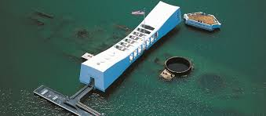
“A day which live in infamy” - The Arizona
http://www.history.com/topics/world-war-ii/us-home-front-during-world-war-ii/videos/uss-arizona-under-attack-at-pearl-harbor?m=528e394da93ae&s=undefined&f=1&free=false
https://abcnews.go.com/US/video/archival-video-disappearing-uss-arizona-44012848

Slide 19
US Enters the War
December 8, 1941 US declares war on Japan
December 11, 1941 Germany declares war on the United States
https://www.youtube.com/watch?v=ufoUtoQLGQY
http://dase.laits.utexas.edu/media/american_politics_collection/viewitem/000117156_400.jpg

Slide 20
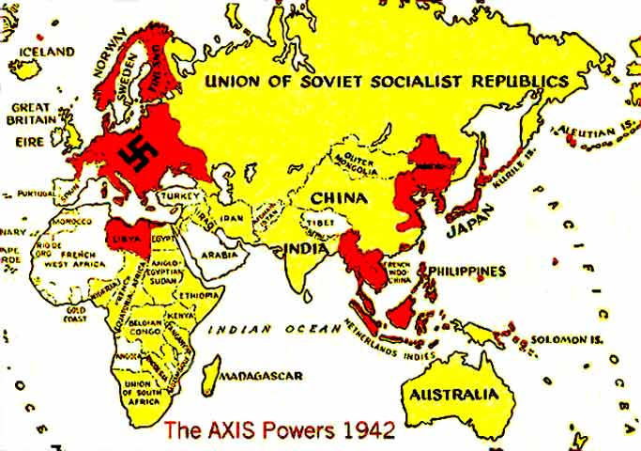

Slide 21
The American Homefront https://www.youtube.com/watch?v=HofnGQwPgqs
The United States government stirs patriotic feelings
Movies are used to build morale
Propaganda is used to keep war effort going
People rationed goods/supplies and started Victory Gardens
http://www.ethicurean.com/wp-content/uploads/image/plant-victory-garden.jpg

Slide 22
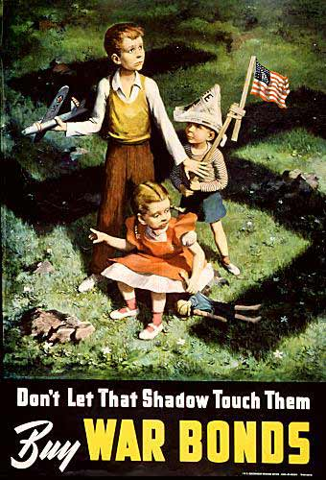
The American Homefront
To raise money to fight the war the U.S. issued war bonds.
A bond is like lending the government money.
What did the government use in this ad motivate people to buy bonds?

Slide 23
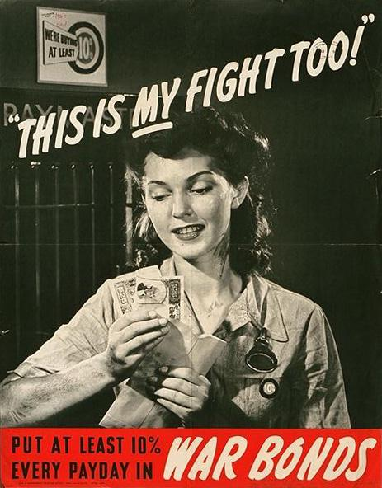
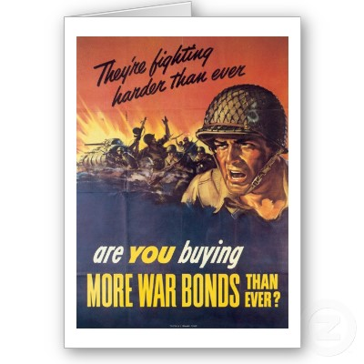

Slide 24
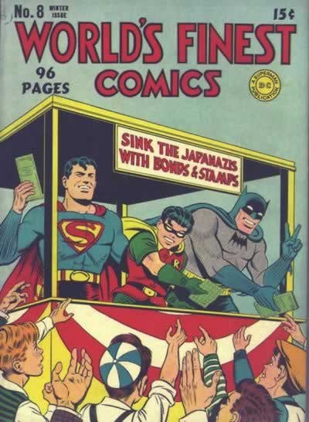
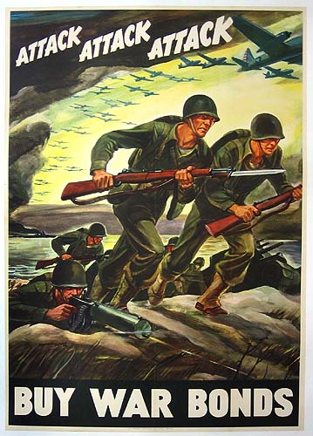

Slide 25
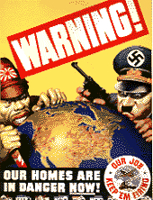
Continued War Effort
http://z.about.com/d/politicalhumor/1/0/R/O/propaganda_quiet.jpg
http://www.teacheroz.com/images/homes.gif

Slide 26
Women Enter the Workforce
http://www.edupics.com/en-coloring-pictures-pages-photo-rosie-the-riveter-p7219.jpg
http://www.rosietheriveterphotos.com/images/070705172615_Woman_Working_a_War_Job_LG.jpg

Slide 27
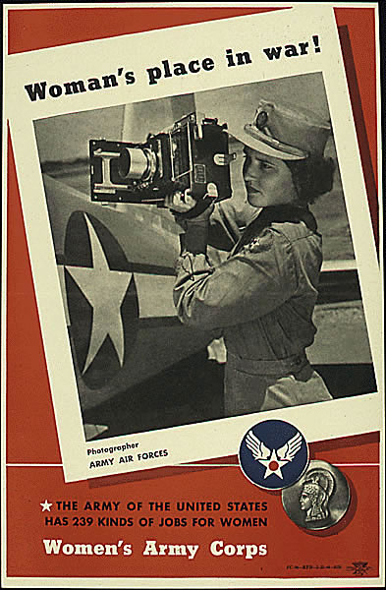
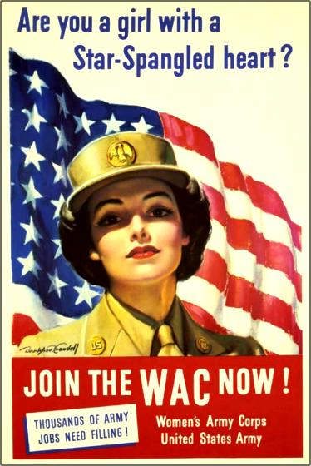
Women Enter the Military
http://www.defenselink.mil/home/features/2005/veday/poster_gallery/images/WWII%20WAC5.jpg
http://www.scripophily.com/webcart/vigs/wacposterstar.jpg

Slide 28
Japanese Americans
Many Japanese Americans served heroically for the US in World War II
The Nisei Regiment received high honors and awards of distinction for bravery
https://www.youtube.com/watch?v=zw_3KO9c_QE

Slide 30
Japanese Americans Interned
Many Americans were distrusting of Japanese Americans
Thousands of Japanese Americans were forced into Internment Camps in the Midwest throughout WWII
https://www.youtube.com/watch?v=cZTioTkHcB0

Slide 31
African Americans in the Military https://www.history.com/topics/world-war-ii/tuskegee-airmen

Slide 32
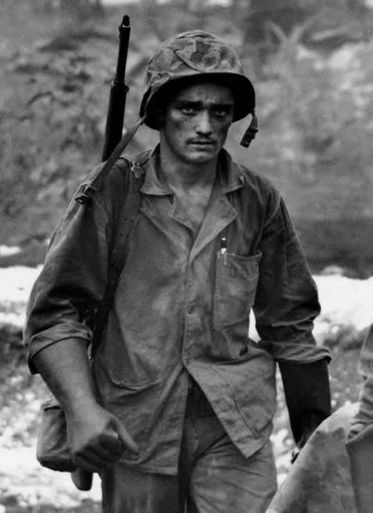
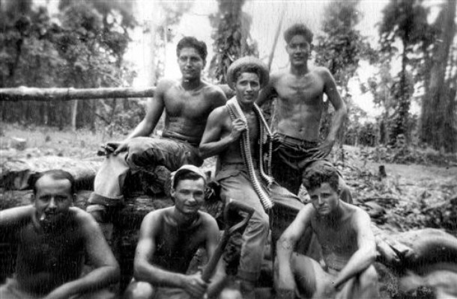
Mexican Americans in the War Effort

Slide 33
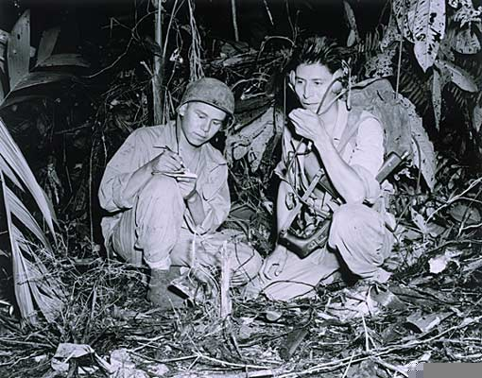
Navajo Code Talkers https://www.youtube.com/watch?v=rO5-14p7ccI

