Slide 1
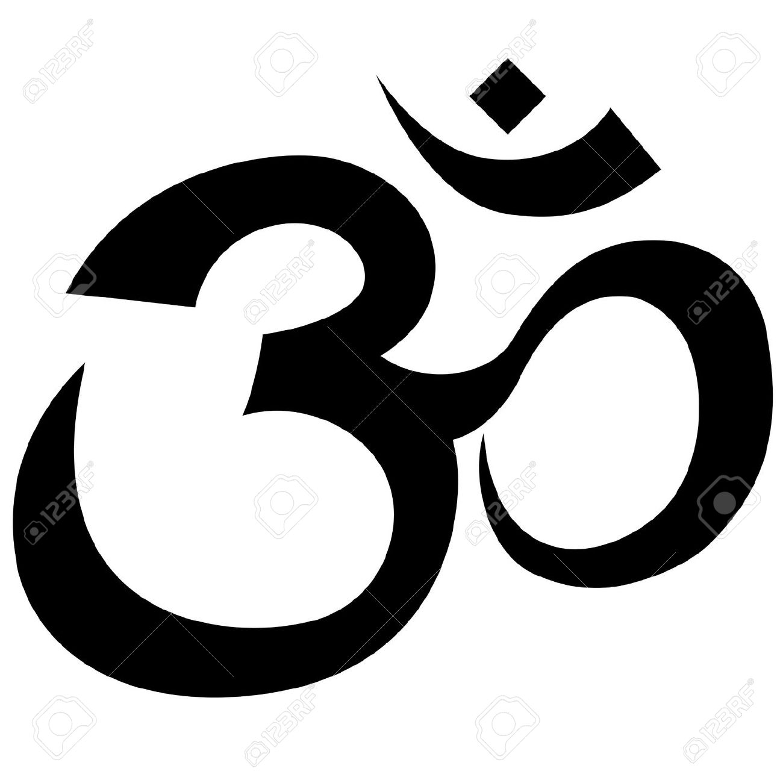
Hinduism and India

Slide 2
The Origins of Hinduism
Today, Hinduism is a major world religion
Began in ancient India
Different than other major religions because there is no single founder.
Based on the Vedas, the sacred texts and teachings of the Aryans, the ancient people who settled in India around 1500 BCE

Slide 3
So what Is Hinduism????
Hinduism is a religion of many gods.
However, all Hindus worship one supreme being who created other gods
One of the unique beliefs in Hinduism is that God is not up in some remote, far away heaven, but is instead inside each and every soul, waiting to be discovered.
Knowing God is always with them gives Hindus great hope and courage.

Slide 4
Main Concepts of Hinduism
Dharma is a person's religious and moral duties
Karma is the Hindu idea that sums up a person’s deeds during their lifetime. The phrase “what goes around comes around” comes from a belief in karma.
Reincarnation is the belief that the individual soul of a person is reborn in a different form after death, based on their karma, or their deeds in their prior life or lives.

Slide 5
Main Concepts of Hinduism
How well you perform your dharma (duty) determines your karma (fate)
If you do a good job, you'll earn good karma, and have a good rebirth
If you do a bad job, you'll earn bad karma, and have a bad rebirth
This continues until you get it right
(VIDEOS DISCOVERY)

Slide 6
The Caste System
The idea of the caste system in ancient India began after the Indus Valley Civilization disappeared and a new people arrived, the Aryans.
The Aryans were nomads from the north.
They brought with them some new ideas.
One of those ideas was Hinduism, which is now a world religion.
Another was the idea of a caste system. A caste is a life-long social group into which a Hindu is born.

Slide 7
The Caste System
The Vedas are the Sanskrit writings that are the earliest sacred texts of Hinduism.
The Vedas suggest the caste system in India.
There were four social classes in the ancient Aryan society.
These were the Brahmins (priests & scholars); warriors & nobles; artisans & merchants; and on the lowest level, farm workers, laborers, servants

Slide 8
The Caste System
The caste system started with just four castes.
In order of importance and power these castes were priests, warriors, traders and farmers, and finally paid workers.
grew progressively more strict until finally you were born into your caste and could not move or marry out of your caste.

Slide 9
The Caste System
Really wasn't part of Hinduism, at first.
Began at about the same time as Hinduism.
Remained in place in India for thousands of years, long after Aryan rule was replaced by other leaders.
Over the years, the caste system became intertwined with Hindu India.

Slide 10
The Caste System
The Brahmins: scholars, priests, teachers, judges, and landowners; lived in temples, removed from society.
The Kshatriya: the warriors; rulers of towns and cities; any decision they made, however, could be overruled by a member of the Brahmin
The Vaishyas: skilled farmers, merchants, and craftsmen; could hold office in village government. They might live in very nice houses. Even though they were three down on the social scale, they still had good clothes and ample food. not the top leaders, but were a respected part of society.
The Sudras: the unskilled workers; might find a job on a farm or a non-skilled job in a home

Slide 11
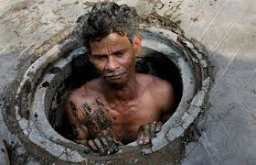
The Untouchables, the people without a caste
the lowest in society in Hindu India,
so low that they were not part of the caste system.
They had no rights; held degrading job that no one else wanted to do.
If your parent was an Untouchable, so were you.
Untouchables could not move up or marry out of their social rank.

Slide 12
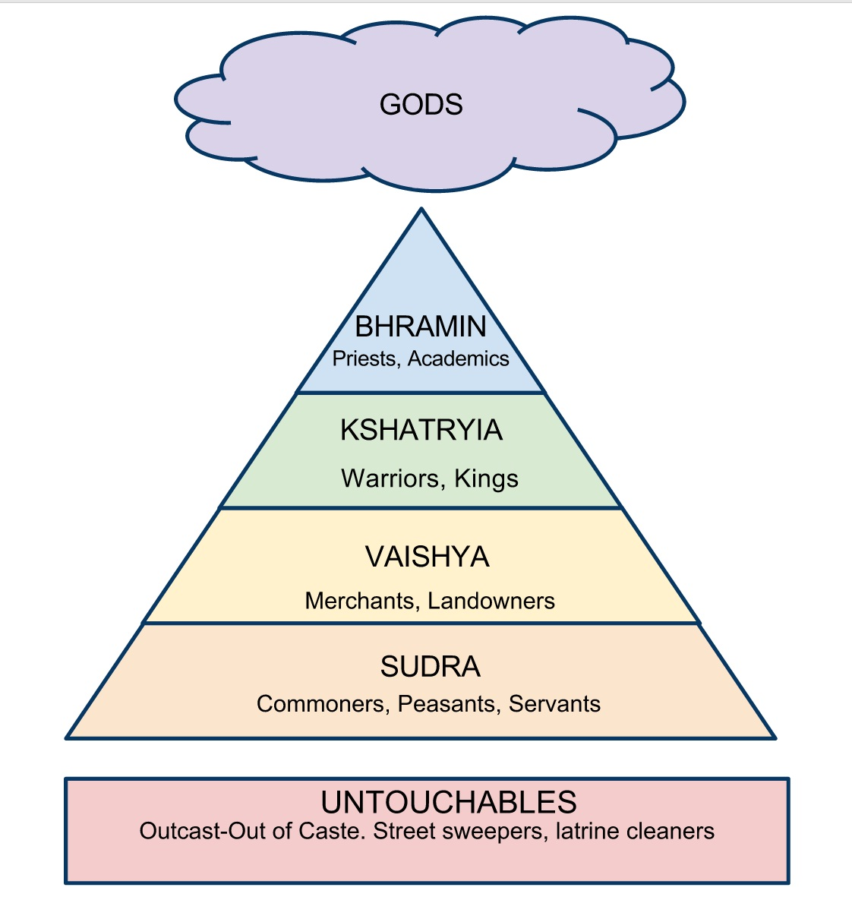
The Caste System

