Slide 1
10 Reasons for the Fall of the Roman

Slide 2
10 Reasons for the Fall of the Roman
Although the last Roman Emperor (Romulus Augustus) fell to barbarian invaders led by Germanic king Odoacer in 476A.D., historians have pointed to other reasons for its decline centuries before that date. The following ten slides offer possible reasons why the Roman Empire fell. Which ones do you think make the most sense? Why?
Possible applications:
Students pick three of the ten reasons and write a persuasive essay arguing why those three reasons are the most significant.
Students put five reasons into their ‘unrealistic’ column and five into their ‘realistic’ column, then compare or debate with peers.
Students make an 8.5” x 11”movie poster for the fictitious film The Fall of Rome. It should include references/visuals relating to four of the ten reasons.
Students research one reason and list seven other facts they learned regarding that topic

Slide 3
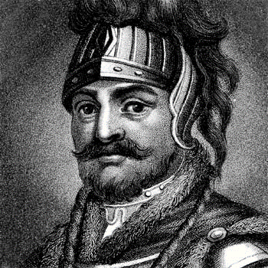
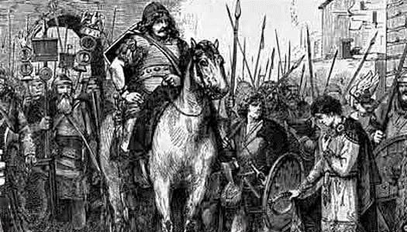
10 Reasons for the Fall of the Roman Empire
1) Barbarian Invasions:
For years, the disciplined Roman Army held the barbarians of Northern Europe in check. But armies were moved to fight civil wars in Italy, leaving the northern border open to attack. Roads and bridges were left to decay and bandits made travel unsafe, so trade also declined. Germanic tribes gradually moved into Roman territories until Germanic general Odovacar invaded Rome in 476A.D.

Slide 4
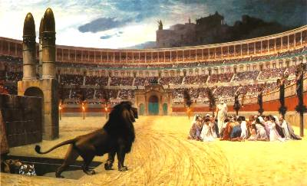
10 Reasons for the Fall of the Roman Empire
2) Declining Morals:
Crime and violence in the streets of large cities made the Empire unsafe. Prostitution was out of control with over 30,000 in Rome under emperor Trajan. Nero and others were known to throw wasteful parties. The popularity of the Coliseum showed the Roman obsession with death and violence.

Slide 5
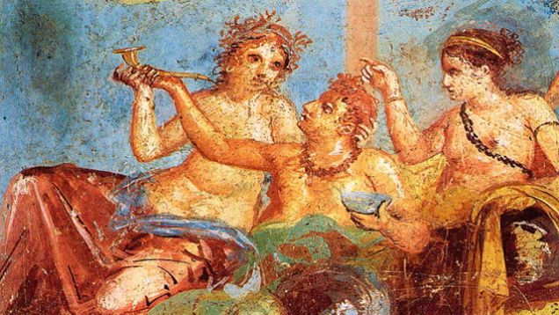
10 Reasons for the Fall of the Roman Empire
3) Heath Issues:
Many believe that countless Romans were killed from lead poisoning. The rich were affected at a higher rate since they could afford lead utensils and lead pipes to bring water into their homes.

Slide 6
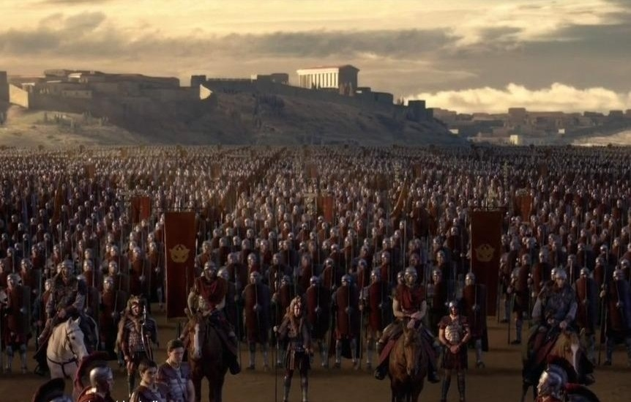
10 Reasons for the Fall of the Roman Empire
4) Excessive Military Spending:
Costs to maintain the army and defend the empire were draining the government funds. Little money was left for public housing, roads and bridges. Mercenaries were used to fight since few Romans had the passion to join the army. These hired soldiers were not only unreliable, but costly. Taxes were raised, especially on businessmen and farmers, which hurt the economy even more.

Slide 7
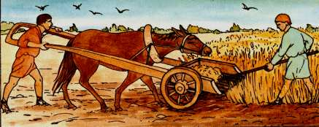
10 Reasons for the Fall of the Roman Empire
5) Inferior Technology:
The most famous Roman inventions were related to public services like medicine, aqueducts, coliseums, roads and bridges. But very little progress was made in farming, machinery, and production of goods. As a result, the empire struggled to meet the needs of their growing population.

Slide 8
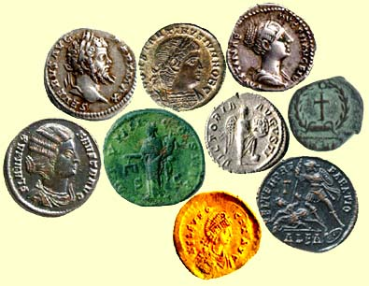
10 Reasons for the Fall of the Roman Empire
6) Inflation:
The Roman economy saw an increase in prices. When expansion and conquering stopped, the flow of gold decreased. The commonly used gold coins were soon mixed with other metals, making them less valuable. Merchants raised prices on goods to make up for lower amounts of gold in each coin. Areas of the empire reverted to the barter system where salaries were paid with clothing and food was collected for taxes.

Slide 9
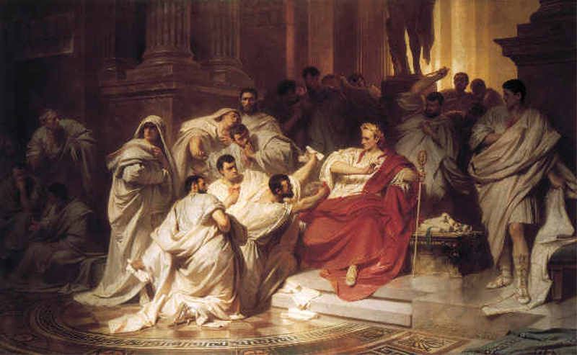
10 Reasons for the Fall of the Roman Empire
7) Corruption:
Since a system was never created to select new emperors, powerful men fought over the issue. The emperor, senators, generals, and Praetorian Guard (emperor’s private army) openly debated about who should be the next emperor. Many of these men would bribe each other for support. By 186A.D., the throne was simply sold to the highest bidder. This led to the assassinations of 25 emperors in the next 100 years.

Slide 10
10 Reasons for the Fall of the Roman Empire
8) Christianity:
Jesus and the apostles operated in a Roman province (Judea), so the empire was a missionary field for early Christians. Christians claimed allegiance to a higher power instead of the emperor. Many emperors targeted Christians with crucifixions, beheadings and torture, but even more believed since they took punishment instead of denying their faith. Constantine later made Christianity the Empire’s official religion.

Slide 11
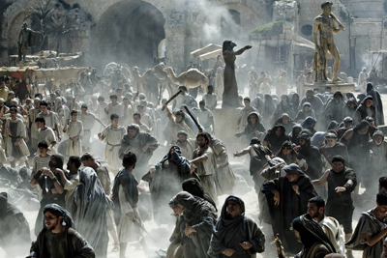
10 Reasons for the Fall of the Roman Empire
9) Unemployment:
Most of the empire’s farming was done by slave labor on the land of wealthy men. Other farmers couldn’t sell crops as cheap as slave labor, so they began moving to the cities looking for jobs, but there were not enough. The emperor was importing grain at one point for 100,000 unemployed men in Rome.

Slide 12
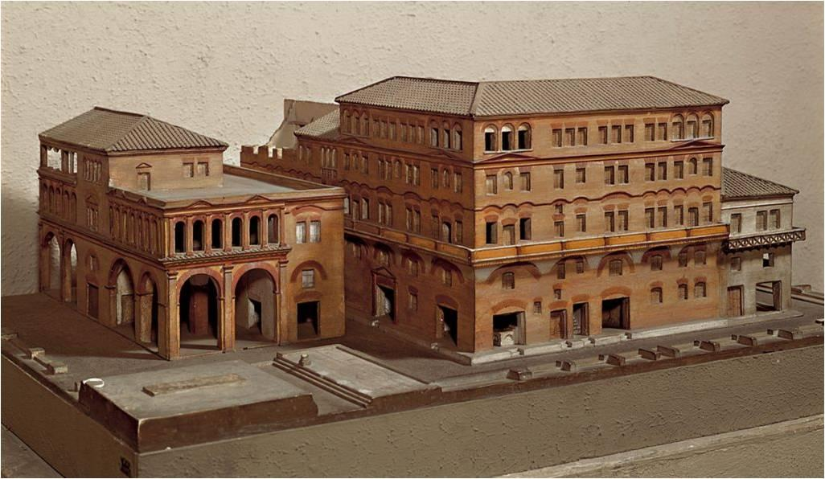
10 Reasons for the Fall of the Roman Empire
10) Urban Decay:
The wealthy lived in marble homes with windows, but the rest had tiny rooms in six-story apartments. Higher apartments were the cheapest, but also the most dangerous. Apartments were dirty, overcrowded, uncomfortable and crime infested. The government had no funds to deal with these problems.

Slide 13
Questions to consider…
10 Reasons for the Fall of the Roman Empire
“A great civilization is not conquered from without until it has destroyed itself from within.” - Will Durant (historian who specialized in studying the Roman Empire)
Put the Will Durant quotation into your own words: _________________________________

Slide 14
Questions to consider…
10 Reasons for the Fall of the Roman Empire
With all the changes and challenges occurring in the Roman Empire, does it seem that most of the problems were internal (from within) or external (from outside)? Cite examples to explain your answer…
_____________________________________
_____________________________________

Slide 15
Questions to consider…
10 Reasons for the Fall of the Roman Empire
What message might the behavior of Roman leaders send to citizens throughout the Roman Empire?
_____________________________________
_____________________________________

